Slide 1
Modernity and the Moral Life
Session 23
Dr. Lewis Winkler • East Asia School of Theology (Singapore) Uploaded by Dr. Rick Griffith • Jordan Evangelical Theological Seminary Files in many languages for free download at BibleStudyDownloads.org

Slide 2
I. Introduction:

Slide 3
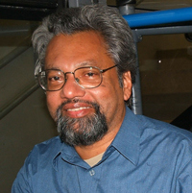
Modernity is the first truly global civilization to emerge in human history. . . . Its impact is felt even in the more remote villages of the world as much as in the universities, commercial centres and government offices of major cities. It is full of paradoxes and ambiguities, bringing in its wake both enormous blessings and terrible sufferings. Vinoth Ramachandra, Gods That Fail, 143

Slide 4
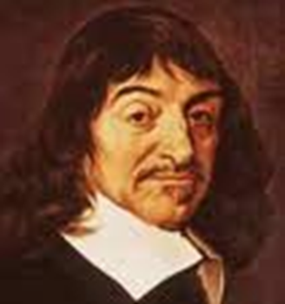
II. Intellectual Strands of Modernity: The Pursuit of and Demand for Certainty in Truth
Two Main Schools of Thought
Rationalism: The Sufficiency of Reason
Cartesian Dualism

Slide 5
II. Intellectual Strands of Modernity: The Pursuit of and Demand for Certainty in Truth
Two Main Schools of Thought
Rationalism: The Sufficiency of Reason
Cartesian Dualism
The Search for a “Traditionless” and “Contextless” Knowledge

Slide 6
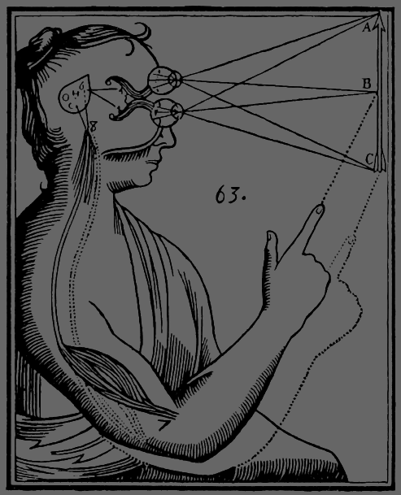
II. Intellectual Strands of Modernity: The Pursuit of and Demand for Certainty in Truth
Two Main Schools of Thought
Empiricism: The Sufficiency of the Senses
Comprehensive Analytic Investigation of Our World

Slide 7
II. Intellectual Strands of Modernity: The Pursuit of and Demand for Certainty in Truth
Two Main Schools of Thought
Empiricism: The Sufficiency of the Senses
Comprehensive Analytic Investigation of Our World
Grand Theories to Explain Everything in Scientifically Natural Terms

Slide 8
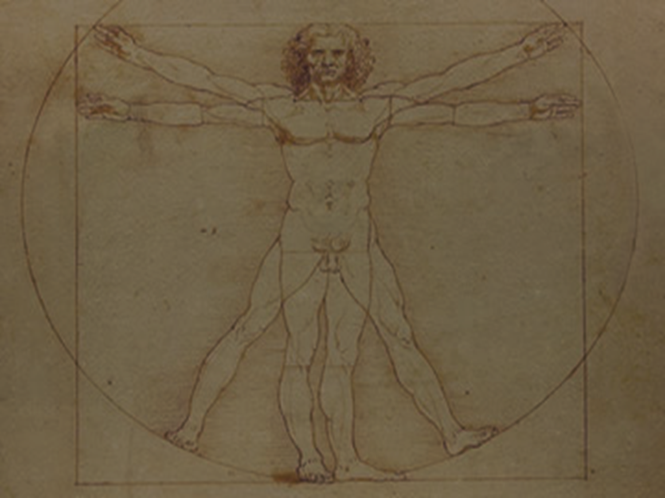
II. Intellectual Strands of Modernity: The Pursuit of and Demand for Certainty in Truth
The Rejection of Traditional Sources of Authority and the Elevation of the Rational Evaluative Self

Slide 9
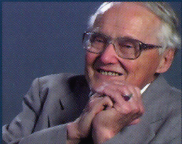
Modernity is distrustful of authority. It was born in a movement of emancipation from what were seen as external authorities, and its appeal was to the freedom and responsibility of the individual reason and conscience to judge between rival truth claims. Lesslie Newbigin, Truth and Authority, 11

Slide 10
II. Intellectual Strands of Modernity: The Pursuit of and Demand for Certainty in Truth
The Assumed Result for Both Schools: Unbridled Human Freedom and Unhindered Human Progress

Slide 11
II. Intellectual Strands of Modernity: The Pursuit of and Demand for Certainty in Truth
Some Ethical Implications
The Idea Ethical Evolution and Progress

Slide 12
II. Intellectual Strands of Modernity: The Pursuit of and Demand for Certainty in Truth
Some Ethical Implications
The Idea of Ethical Evolution and Progress
A Focus on Humanity’s Ability to Solve All Ethical Problems

Slide 13
II. Intellectual Strands of Modernity: The Pursuit of and Demand for Certainty in Truth
Some Ethical Implications
The Irrelevance (and Perhaps Even Insidiousness) of the Divine in Ethical Judgments

Slide 14
II. Intellectual Strands of Modernity: The Pursuit of and Demand for Certainty in Truth
Some Ethical Implications
The Irrelevance (and Perhaps Even Insidiousness) of the Divine in Ethical Judgments
The Secularization (and Subsequent Impoverishment) of Christian Ethics

Slide 15
III. Industrial/Technological Strands of Modernity: The Rise of “Technism”
The Industrial Revolution and the Rise of the Technological
The Demand for and Love of Efficiency

Slide 16
III. Industrial/Technological Strands of Modernity: The Rise of “Technism”
The Industrial Revolution and the Rise of the Technological
The Demand for and Love of Efficiency
The Passionate Push for a Sense of Control over Nature, Human Relationships, and the Self

Slide 17
III. Industrial/Technological Strands of Modernity: The Rise of “Technism”
The Ethics of the Technological
New Ethical Quandaries and the Myth of Technological Control

Slide 18
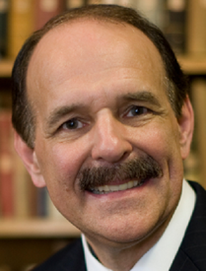
Technology . . . always carries with it a certain kind of control over us. The premise that we can easily control technologies toward moral ends is not at all self-evident. Most of the great ethical issues grappled with today are somehow related to our technological sophistication. Our capabilities to create and manufacture outpace our moral sensibilities. Dennis P. Hollinger, Choosing the Good, 95

Slide 19
III. Industrial/Technological Strands of Modernity: The Rise of “Technism”
The Ethics of the Technological
The Ascendance of Technique over Morality

Slide 20
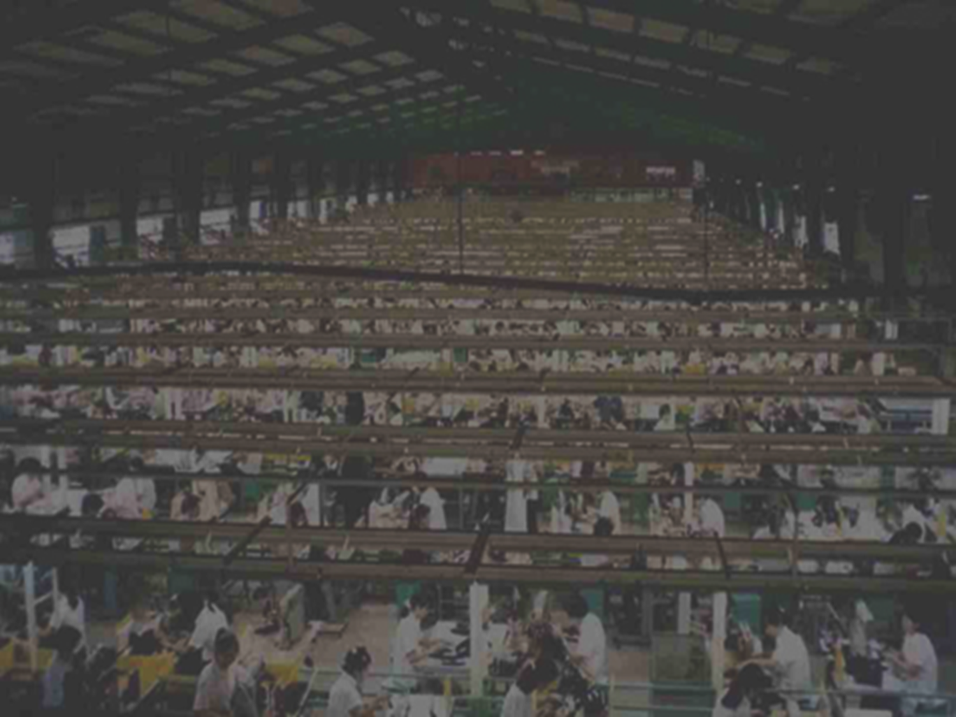
IV. Sociological Strands of Modernity
Differentiation and Specialization
Of Economic Production and Labor

Slide 21
IV. Sociological Strands of Modernity
Differentiation and Specialization
Of Economic Production and Labor
Of Education

Slide 22
IV. Sociological Strands of Modernity
Differentiation and Specialization
Of Economic Production and Labor
Of Education
Of Politics and Law

Slide 23
IV. Sociological Strands of Modernity
Differentiation and Specialization
Of Economic Production and Labor
Of Education
Of Politics and Law
Of Applied Ethics

Slide 24
IV. Sociological Strands of Modernity
Pluralization: Intensifications of:
Geographic Mobility

Slide 25
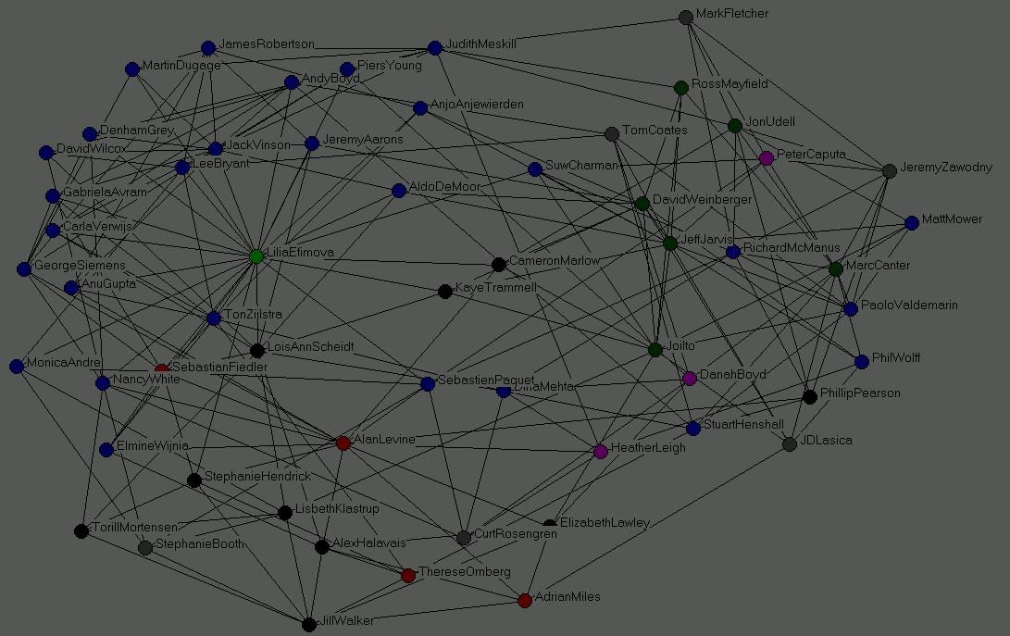
IV. Sociological Strands of Modernity
Pluralization: Intensifications of:
Geographic Mobility
Informational Exchange

Slide 26
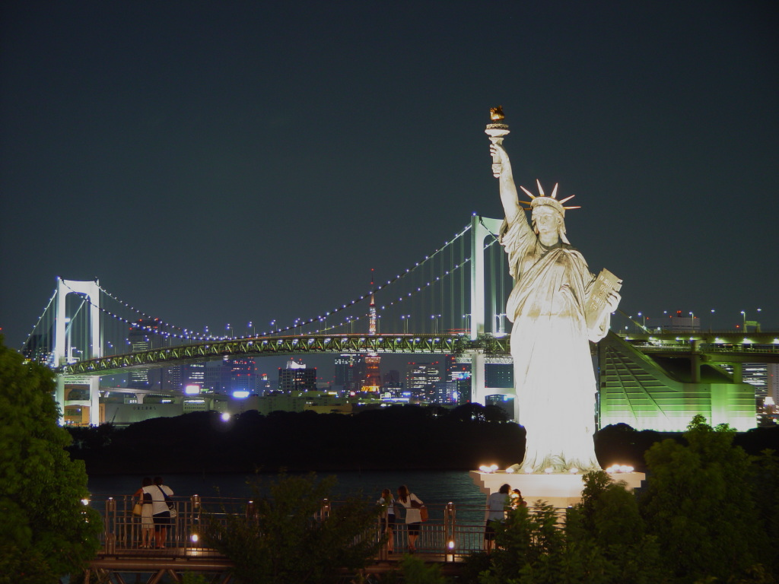
IV. Sociological Strands of Modernity
Pluralization: Intensifications of:
Geographic Mobility
Informational Exchange
Cosmopolitan Centers (i.e., World Cities)

Slide 27
IV. Sociological Strands of Modernity
Pluralization: Intensifications of:
Geographic Mobility
Informational Exchange
Cosmopolitan Centers (i.e., World Cities)
Challenges to Basic Religious and Ethical Conceptions of Reality

Slide 28
IV. Sociological Strands of Modernity
Pluralization: Intensifications of:
Justification for Ethical Relativism

Slide 29
IV. Sociological Strands of Modernity
Pluralization: Intensifications of:
Justification for Ethical Relativism
The Marginalization of a Specifically Christian Ethical Viewpoint

Slide 30
IV. Sociological Strands of Modernity
Secularization

Slide 31
[T]hough religion still plays a significant role in the lives of people and continues to influence societies and cultures, it does not play the same role it once played in relation to major social institutions such as government, economics, education, and law. . . . [W]ithin secularized societies, religion tends to have minimal impact on the larger societal institutions and the main contours of cultural life. Religion, therefore, is one social institution alongside others, no longer providing the overarching framework for the society. Dennis P. Hollinger, Choosing the Good, 101

Slide 32
IV. Sociological Strands of Modernity
Privatization of Religion

Slide 33
V. Conclusion: Modernity: The Blessing and the Curse

Slide 34
Black

Slide 35
Worldview link at BibleStudyDownloads.org
Get this presentation for free!
Notes:
WV (Worldviews)

